Slide 1

Selected Topics in Computational Intelligence I
Session 7
Introduction to Artificial Neural Networks

Slide 2
Agenda
Introduction ot Artificial Neural Networks
Introduction to neuron
Perceptron
Perceptron Exercise and Demo

Slide 3
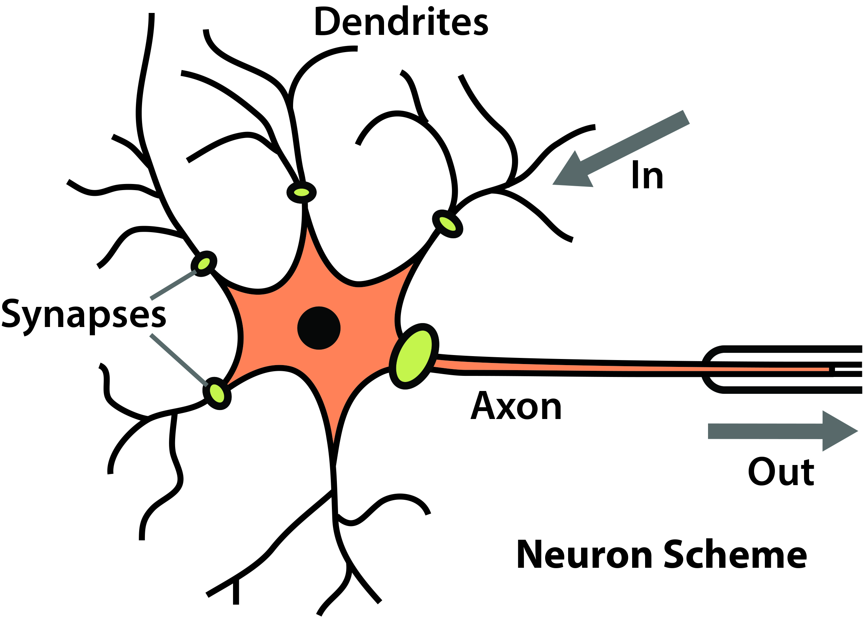
What is Artificial Neural Network
A machine that is designed to model the way in which the brain performs a particular task or function of interest.
Neural network performs useful computations through a process of learning.
In other words, a neural network can be viewed as an adaptive machine.

Slide 4
Artificial Neural Networks
The brain is a complex, nonlinear and parallel computer.
It has the ability to perform tasks such as pattern recognition, perception and motor control much faster than any computer
An artificial neuron (AN) is a model of a biological neuron (BN). Each AN receives signals from the environment, gathers these signals, and when fired, transmits a signal to all connected ANs.

Slide 5
Introduction
Some of the classes of applications to which artificial NNs have been applied include:
classification, where the aim is to predict the class of an input vector;
pattern matching, where the aim is to produce a pattern best associated with a given input vector;
pattern completion, where the aim is to complete the missing parts of a given input vector;
optimization, where the aim is to find the optimal values of parameters in an optimization problem;
control, where, given an input vector, an appropriate action is suggested;
Data mining, with the aim of discovering hidden patterns from data – also referred to as knowledge discovery.

Slide 6
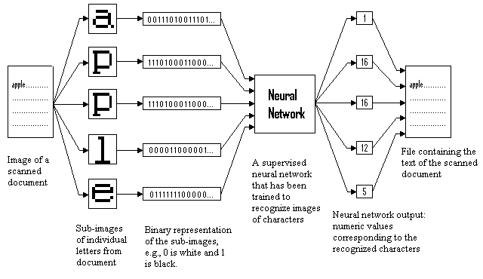
Application: Character recognition

Slide 7

Neural Network
A neural network is basically a realization of a nonlinear mapping from to
where I and K are respectively the dimension of the input and target (desired output) space. The function fNN is usually a complex function of a set of nonlinear functions, one for each neuron in the network.

Slide 8

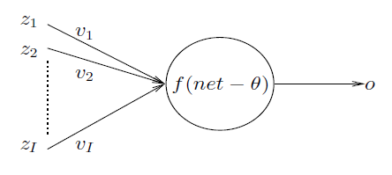
Artificial Neuron
An artificial neuron (AN), or neuron, implements a nonlinear mapping from R^{I} usually to [0, 1] or [−1, 1], depending on the activation function used
where I is the number of input signals to the AN. To each input signal, z_{i}, is associated a weight, v_{i}, to strengthen or deplete the input signal. Threshold value is Ɵ

Slide 9
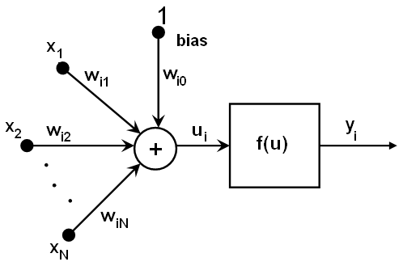

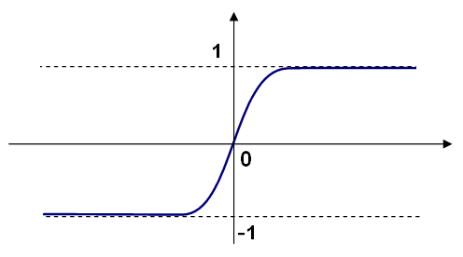
Perceptron
Frank Rosenblatt introduced a training algorithm that provided the first procedure for training a simple ANN: a perceptron.

Slide 10
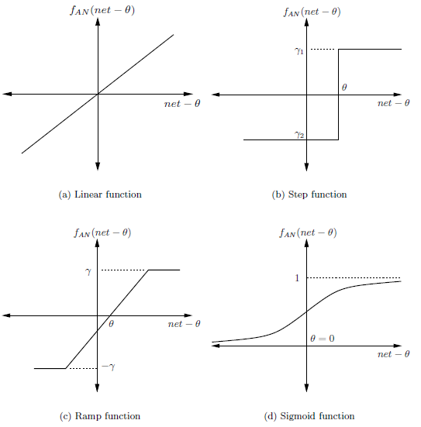

Activation Functions
The function f_{AN} receives the net input signal and bias, and determines the output (or firing strength) of the neuron.

Slide 11
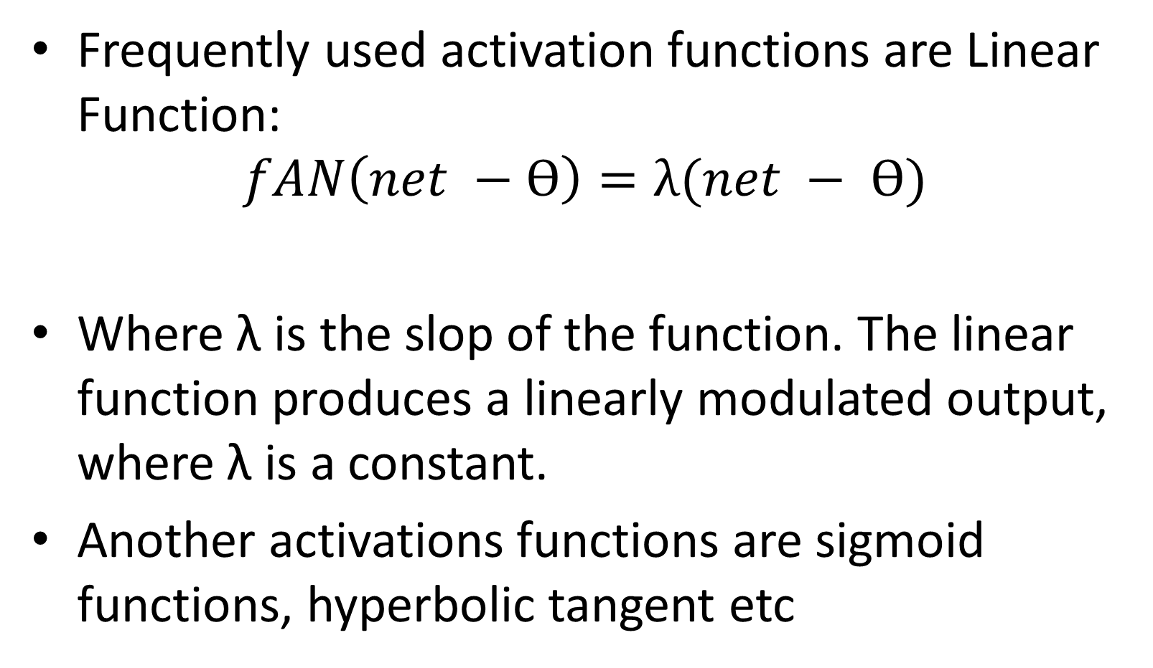
Activation Functions
Notes:
E

Slide 12
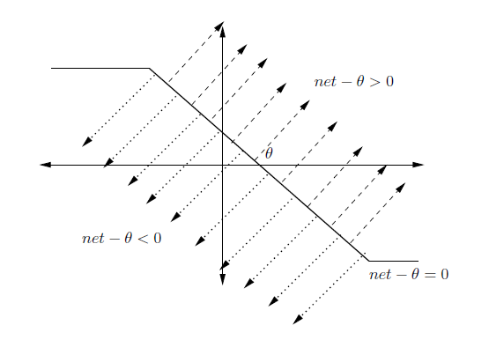
Artificial Neuron Boundary
Single neurons can be used to realize linearly separable functions without any error. Linear separability means that the neuron can separate the space of I-dimensional input vectors yielding an above-threshold response from those having a below-threshold response by an I-dimensional hyperplane.

Slide 13
Artificial Neuron Learning
There are three main types of learning:
Supervised learning, where the neuron (or NN) is provided with a data set consisting of input vectors and a target (desired output) associated with each input vector. The aim of supervised training is then to adjust the weight values such that the error between the real output, o = f(net−θ), of the neuron and the target output, t, is minimized.
Unsupervised learning, where the aim is to discover patterns or features in the input data with no assistance from an external source.
Reinforcement learning, where the aim is to reward the neuron (or parts of a NN) for good performance, and to penalize the neuron for bad performance.

Slide 14
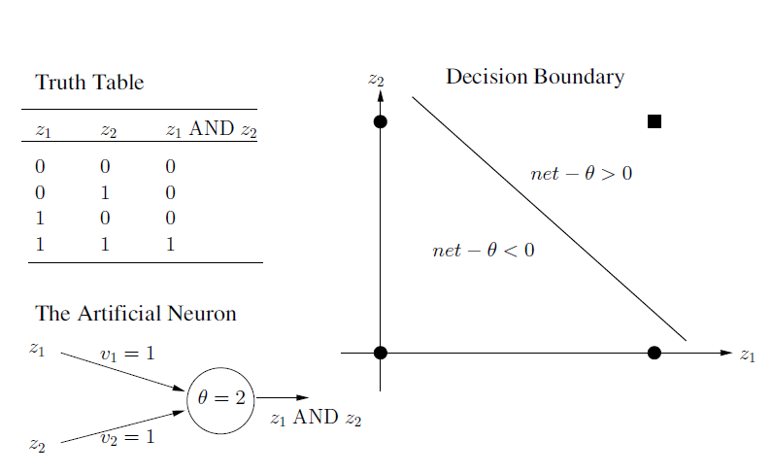
Example
Linearly separable boolean perceptron

Slide 15
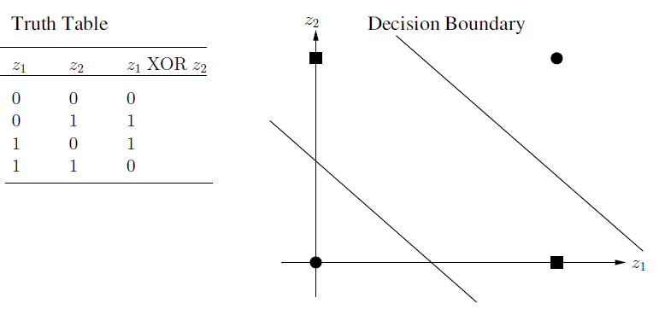
XOR problem
An example of a Boolean function that is not linearly separable is the XOR . A single perceptron can not implement this function.
XOR function requires NN with two input units, two hidden units and one output unit.

Slide 16

Gradient Descent
GD requires the definition of an error (or objective) function to measure the neuron’s error in approximating the target. The sum of squared errors
is usually used, where t_{p} and o_{p} are respectively the target and actual output, and P_{T} is the total number of input-target vector pairs (patterns) in the training set.

Slide 17
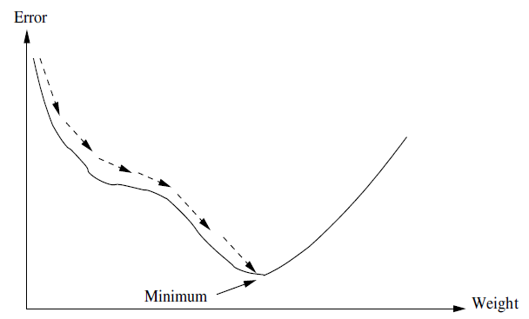
Gradient Descent
The aim of GD is to find the weight values that minimize E. This is achieved by calculating the gradient of E in weight space, and to move the weight vector along the negative gradient

Slide 18
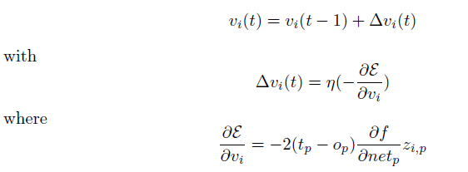
Gradient Descent
Given a single training pattern, weights are updated using
and η is the learning rate (i.e. the size of the steps taken in the negative direction of the gradient). The calculation of the partial derivative of f with respect to netp (the net input for pattern p) presents a problem for all discontinuous activation functions.

Slide 19
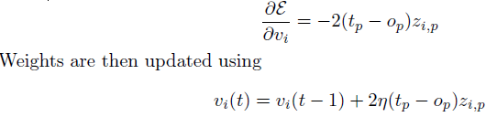
Widrow-Hoff Learning Rule
Assume that f = net_{p}. Then ∂f /∂net_{p} = 1, giving
Widrow-Hoff learning rule, also referred to as the least-means-square (LMS) algorithm, was one of the first algorithms used to train layered neural networks with multiple adaptive linear neurons.

Slide 20
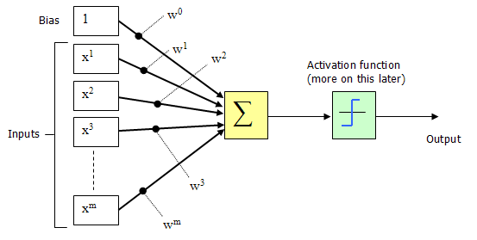
Widrow-Hoff Learning Rule
The 1950s & 1960s: The First Golden Age of Neural Networks
Perceptrons
Group of researchers (Black, 1962; Minsky & Papert, 1969; Rosenblatt, 1958, 59, 62)
Frank Rosenblatt introduced a training algorithm that provided the first procedure for training a simple ANN: a perceptron.

Slide 21
Exercise
Create a program to calculate the output Neuron Y With 2 data input {0.3,0.7} weight=0.2 and theta =0.5

Slide 22
answer
double x[2]={0.3,0.7};
double w = 0.6;
double X=0;
double tetha= 0.5;
for(int i=0; i<2; i++) {
X+=(x[i]*w);
}
if(X>=tetha){
printf("output +1");
}else {
printf("output -1");
}

Slide 23
Matrix in C#
1 2
3 4
6
The weight matrix can be defined in C# as follows:
Matrix weightMatrix=new Matrix(3,2)

Slide 24
Matrix in C#(con’t)
Double [,] matrixData= { {1.0,2.0, 3.0, 4.0},
{5.0, 6.0,7.0, 8.0}
};
Matrix matrix= new Matrix {matrixData);

Slide 25
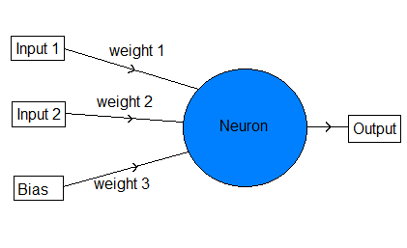
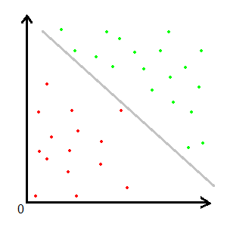
Simple AND
int[,] input = new int[,] { { 1, 0 }, { 1, 1 }, { 0, 1 }, { 0, 0 } };
int[] outputs = { 0, 1, 0, 0 };

Slide 26
Training algorithm
loop
for each training item
compute output using x-values
compare computed output to known output
if computed is too large
make weights and bias values smaller
else if computed is too small
make weights and bias values larger
end if
end for
end loop

Slide 27
Simple Perceptron
Output = input[0] * weight[0] + input[1] * weight[1] + bias * weights[2] If the output is greater than (or equal to) 0 it returns 1, else it returns 0.
LocalError = desiredOutput - calculatedOutput For 2 input values, we get one output, but that output is not always correct, so he have to calculate the error.
Weight[i] = weight[i] + learningRate * localError * input[i] Adjusting weights for Inputs.
Weight[i] = weight[i] + learningRate * localError * bias Adjusting weight for bias (which is 1).
totalError = totalError + Math.Abs(localError)

Slide 28
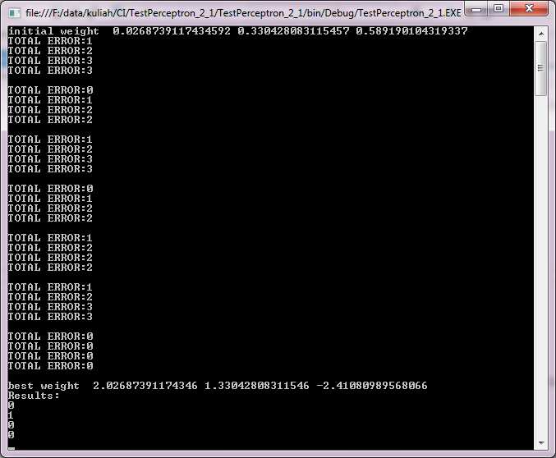
Result

Slide 29
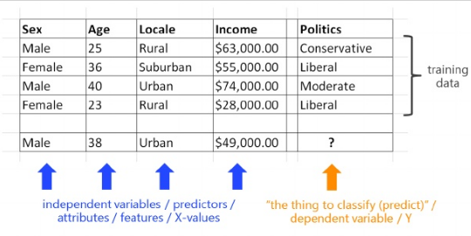
Example Problem
Typical problem that might be solved by NN
The goal of the problem is to predict a person's political inclination based on his or her gender, age, home location, and annual income.

Slide 30
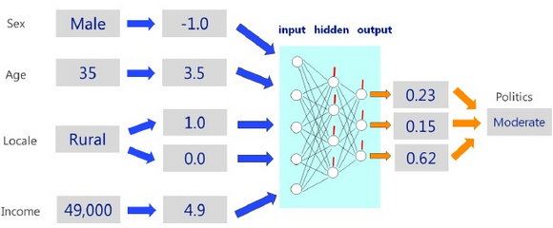
Solution
Represents a neural network that predicts the political inclination of a male who is 35 years old, lives in a rural area, and has an annual income of $49,000.00

Slide 31
Normalization
The demo program begins by setting up four hypothetical training data items with x-values for people's gender, age, home location, and annual income, and y-values for political inclination (conservative, liberal, or moderate). The first line of dummy data is:
Male 25 Rural 63,000.00 Conservative

Slide 32
Normalization
The demo performs encoding on the non-numeric data (gender, locale, and politics). There are two kinds of encoding used, effects encoding for non-numeric x-values and dummy encoding for non-numeric y-values. The first line of the resulting encoded data is:
-1 25 1 0 63,000.00 1 0 0

Slide 33
Normalization
After all data has been converted to numeric values, the data is stored into a matrix in memory and displayed. Next, the demo performs normalization on the numeric x-values (age and income). The first line of encoded and normalized data is:
-1.00 -0.84 1.00 0.00 0.76 1.00 0.00 0.00

Slide 34
Gaussian Normalization
The demo uses two different types of normalization, Gaussian normalization on the age values, and min-max normalization on the income values.
Values that are Gaussian normalized take on values that are typically between -10.0 and +10.0.
Values that are min-max normalized usually take on values that are between 0.0 and 1.0, or between -1.0 and +1.0.

Slide 35
Gaussian Normalization (con’t)
static void GaussNormal(double[][] data, int column) {
int j = column; // Convenience.
double sum = 0.0;
for (int i = 0; i < data.Length; ++i)
sum += data[i][j];
double mean = sum / data.Length;
double sumSquares = 0.0;
for (int i = 0; i < data.Length; ++i)
sumSquares += (data[i][j] - mean) * (data[i][j] - mean);
double stdDev = Math.Sqrt(sumSquares / data.Length);
for (int i = 0; i < data.Length; ++i)
data[i][j] = (data[i][j] - mean) / stdDev;
}

Slide 36
Min-Max Normalization
The min-max normalized value for the first age, 25, is (25 - 23) / (40 - 23) = 2 / 17 = 0.118.
static void MinMaxNormal(double[][] data, int column) {
int j = column; double min = data[0][j];
double max = data[0][j]; for (int i = 0; i < data.Length; ++i) {
if (data[i][j] < min) min = data[i][j];
if (data[i][j] > max) max = data[i][j];
} double range = max - min;
if (range == 0.0) // ugly
{ for (int i = 0; i < data.Length; ++i)
data[i][j] = 0.5; return; }
for (int i = 0; i < data.Length; ++i)
data[i][j] = (data[i][j] - min) / range;
}

Slide 37
Min-Max Normalization (con’t)
public int ComputeOutput(double[] xValues) {
if (xValues.Length != numInput)
throw new Exception("Bad xValues in ComputeOutput");
for (int i = 0; i < xValues.Length; ++i)
this.inputs[i] = xValues[i];
double sum = 0.0;
for (int i = 0; i < numInput; ++i)
sum += this.inputs[i] * this.weights[i];
sum += this.bias;
int result = Activation(sum);
this.output = result;
return result;
}

Slide 38
Min-Max Normalization (con’t)
int c = p.ComputeOutput(newData[i]);
Console.Write("Prediction is ");
if (c == -1)
Console.WriteLine("(-1) liberal");
else if (c == 1)
Console.WriteLine("(+1) conservative");

Slide 39
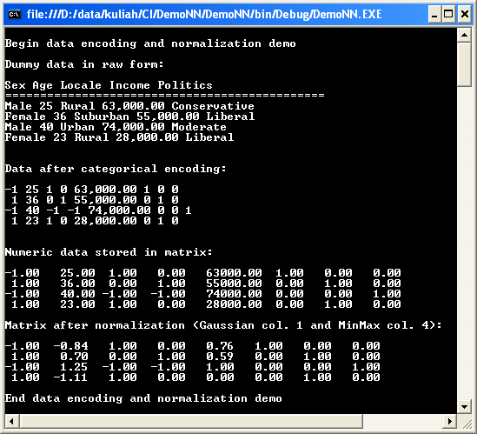
Result

Slide 40
Demo
The demo begins by setting up eight dummy training data items:
1.5 2.0 -> -1
2.0 3.5 -> -1
3.0 5.0 -> -1
3.5 2.5 -> -1
4.5 5.0 -> 1
5.0 7.0 -> 1
5.5 8.0 -> 1
6.0 6.0 -> 1
The first data item can be interpreted to mean that a person whose age is 1.5 and whose income is 2.0 is known to be a liberal (-1).
Here, age has been normalized in some way, for example by dividing actual age in years by 10 and then subtracting 0.5, so 1.5 corresponds to a person who is 20 years old.

Slide 41
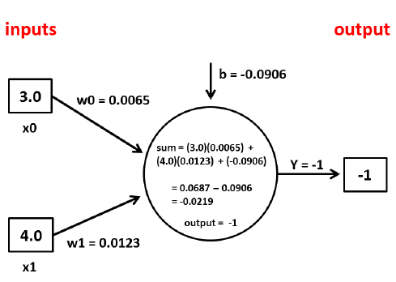
Demo
sum = (3.0)(0.0065) + (4.0)(0.0123) = 0.0687

Slide 42
Bias value
One factor that can cause great confusion for beginners is the interpretation of the bias value. A perceptron bias value is just a constant that is added to the processing sum before the activation function is applied.
The next step is to add the bias value to the sum:
sum = 0.0687 + (-0.0906) = -0.0219

Slide 43
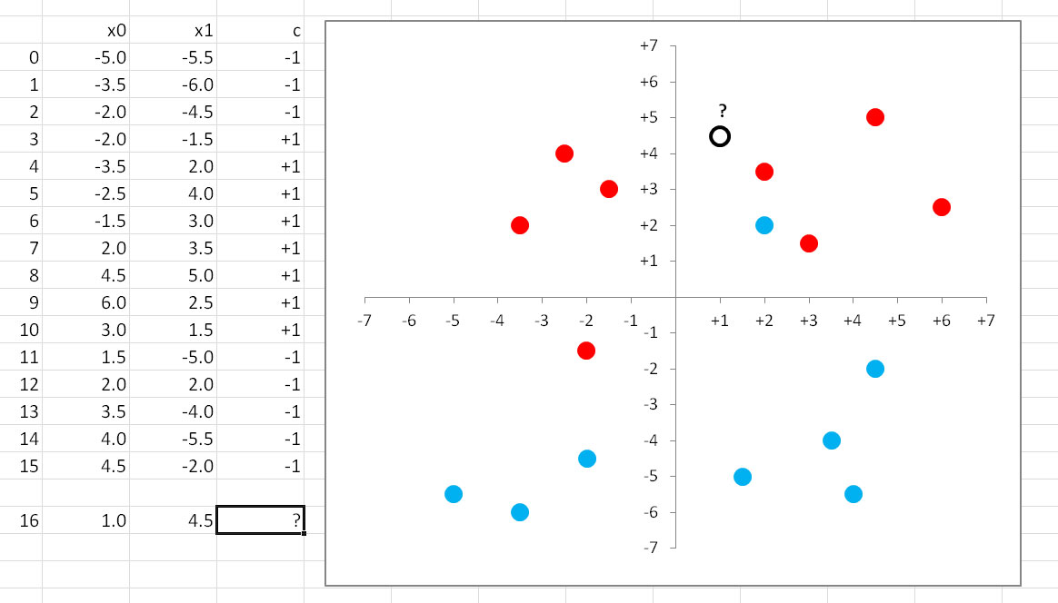
Perceptron Classification

Slide 44
Perceptron Classification (con’t)
double[][] trainData = new double[16][];
trainData[0] = new double[] { -5.0, -5.5 };
trainData[1] = new double[] { -3.5, -6.0 };
trainData[2] = new double[] { -2.0, -4.5 };
trainData[3] = new double[] { -2.0, -1.5 };
trainData[4] = new double[] { -3.5, 2.0 };
….
trainData[9] = new double[] { 6.0, 2.5 };
trainData[10] = new double[] { 3.0, 1.5 };
trainData[11] = new double[] { 1.5, -5.0 };
//trainData[12] = new double[] { 2.0, -2.5 }; // possible perfect classification
trainData[12] = new double[] { 2.0, 2.0 }; // data cannot be perfectly classified
trainData[13] = new double[] { 3.5, -4.0 };
trainData[14] = new double[] { 4.0, -5.5 };
trainData[15] = new double[] { 4.5, -2.0 };
int[] Y = new int[16] { -1, -1, -1, 1, 1, 1…, 1, 1, -1, -1, -1, -1, -1 };

Slide 45
Compute
static int ComputeOutput(double[] data, double[] weights, double bias) // -1 ot +1
{
double result = 0.0;
for (int j = 0; j < data.Length; ++j)
result += data[j] * weights[j];
result += bias;
return Activation(result);
}
static int Activation(double x)
{
if (x >= 0.0) return +1;
else return -1;
}

Slide 46
References
Adries P. Engelbrect(2007), Computational Intelligence An Introduction. 2nd ed. John Wiley & Sons. USA.
James McCaffrey (2014),Neural Network using C# Succintly, Syncfusion Publisher, 2014.
http://docs.opencv.org/modules/ml/doc/neural_networks.html

Slide 47
Thank You

